Slide 1

Machine Learning Result
Trade Flow Dynamics in Oceania (2015–2025)
Arnav Padole
22070521110
Sem: VII
Under the guidance of
Dr. Piyush Chauhan
Symbiosis Institute of Technology, Nagpur Campus

Slide 2

Data Quality and Preparation Summary
The analysis was conducted on a cleaned dataset of 91,553 trade records from the Oceania region, covering a ten-year period (Jan 2015–Mar 2025).
The dataset contained minimal data quality issues — only one missing entry in the “unit” column, which was handled during preprocessing.
All essential variables including transaction date, country name, and monetary values (USD & Rupees) were verified and ready for analysis.
Data preprocessing steps included:
Handling missing values
Ensuring correct data types (date, numeric)
Standardizing currency values
Removing duplicates
0
04
3

Slide 3
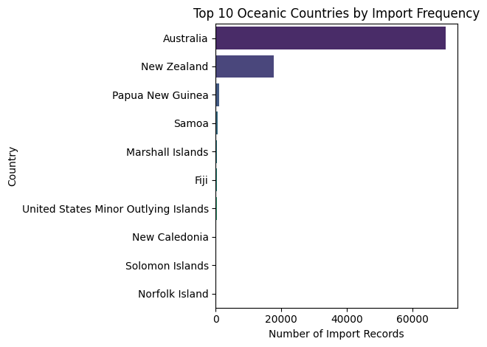
Result 1: Geographic Concentration of Trade
0
04
Australia emerged as the dominant trade hub, accounting for over 70,000 records, approximately 77% of all documented transactions.
The “Australia and New Zealand” sub-region collectively drives the majority of trade activity in Oceania.
This indicates that regional hubs and bilateral partnerships are key drivers of trade dynamics in the region.
3

Slide 4
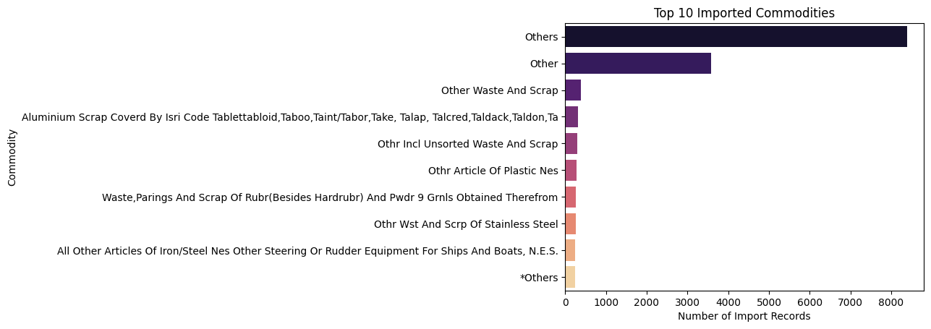
Result 2: Top Traded Commodities (By Value)
0
04
The top traded commodities show a diverse mix of industrial and natural goods.
The ‘Others’ category accounts for the largest cumulative trade value, suggesting that the Oceania market is highly diversified across smaller commodity segments.
3

Slide 5
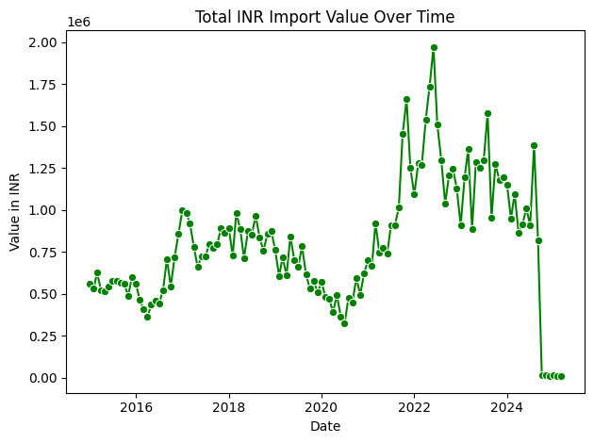
Result 3: Temporal Trends in Trade Value
0
04
The overall trade value trend across 2015–2025 shows a steady upward trajectory, indicating growth and resilience in regional trade.
Seasonal fluctuations are visible, with trade peaks observed in Q4 (Oct–Dec) and consistent dips in Q2 (Apr–Jun).
3

Slide 6
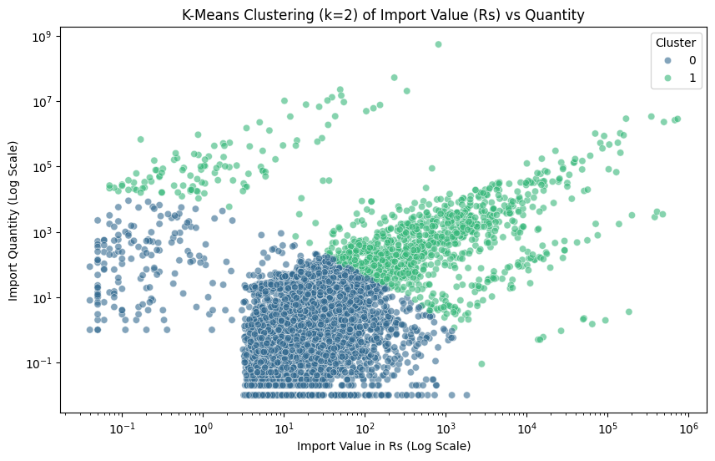
Result 4:Clustering Analysis: Trade Behavior Segmentation
0
04
K-Means clustering (k=2) applied on Import Value (Rs) and Quantity to identify trade patterns.
Cluster 0: High-value, low-quantity imports (premium goods).
Cluster 1: Low-value, high-quantity imports (bulk commodities).
Visualization shows bimodal trade behavior and extreme outliers.
Highlights regional mix of mass-scale bulk trade and high-margin niche goods.
3

Slide 7
Result 5: Commodity Performance Over Time
0
Base Metals and Agricultural Products are the top traded commodities in Oceania.
Agricultural Products led total trade value until 2020.
Post-2021, Base Metals grew steadily and overtook Agriculture, reflecting industrial expansion.
Highlights a shift in trade composition and evolving market priorities.
04
3

Slide 8
Final Summary of Findings
Dominant Trade Hub: Australia accounts for ~77% of all transactions, driving regional trade.
Trade Composition: Mix of high-volume bulk goods (e.g., minerals, agricultural products) and specialized, high-value commodities (e.g., precious stones, machinery).
Temporal Trends: Trade values show steady growth with seasonal peaks over the decade (2015–2025).
Market Evolution: Commodity performance shifted over time — Base Metals overtook Agricultural Products post-2021, reflecting industrial expansion and changing market demand.
Strategic Insight: Understanding trade segmentation and temporal trends can guide policy decisions, business strategy, and market prioritization in Oceania.

Slide 9
Thank You!

